Slide 1
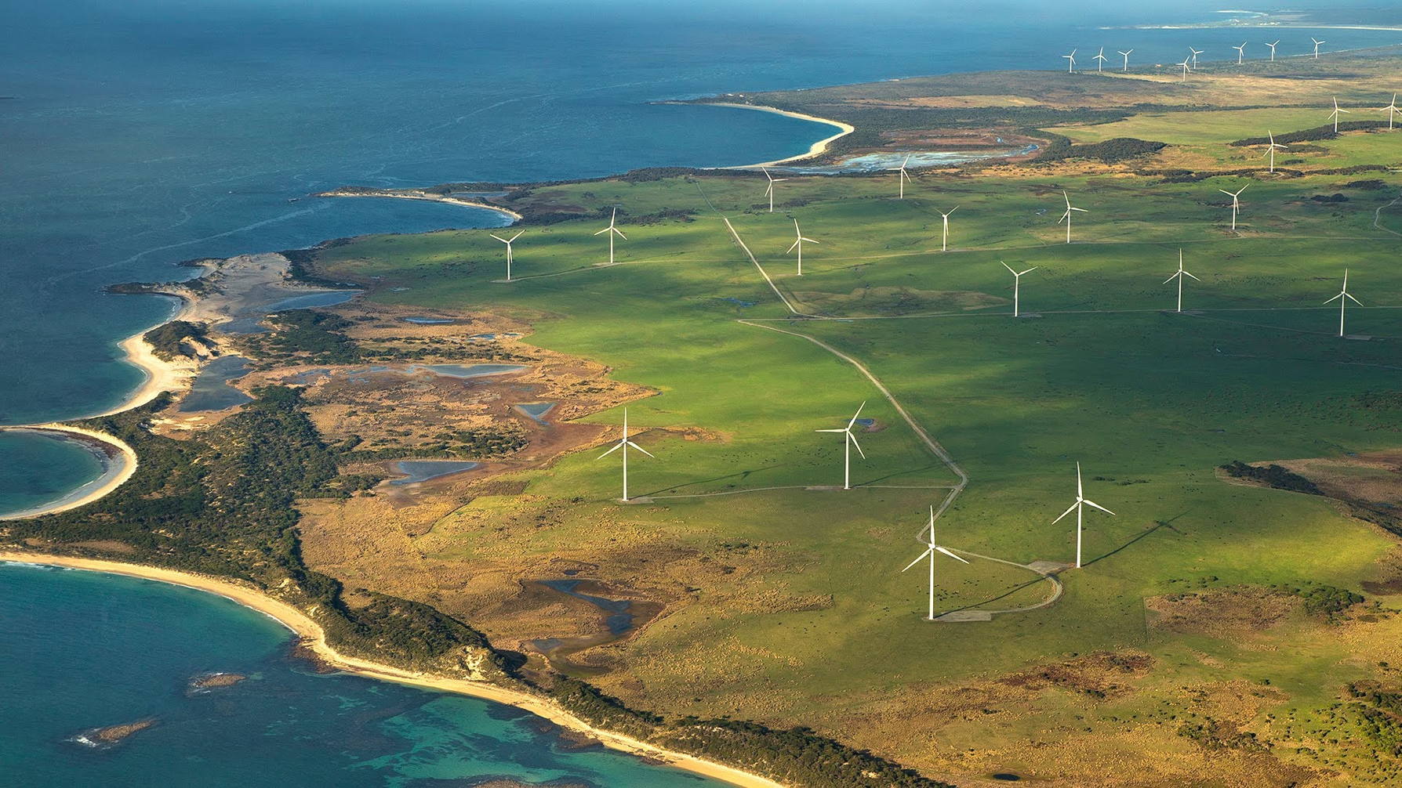
Best Practices for
Wake Model and Optimization Algorithm Selection
in Wind Farm Layout Optimization
Nicholas F. Baker , Andrew P. J. Stanley , Jared J. Thomas, and Andrew Ning
Brigham Young University, Provo, Utah 84602
Katherine Dykes
National Renewable Energy Laboratory, Golden, Colorado 80401
SciTech 2019

Slide 2
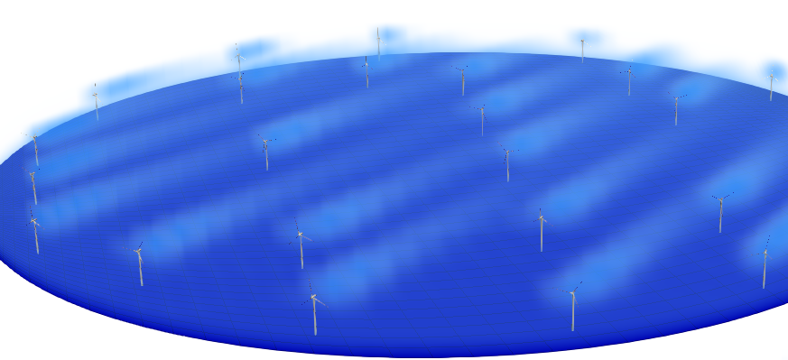
Notes:
WIFM:
Placement of turbines is important due to wake
SADS

Slide 3
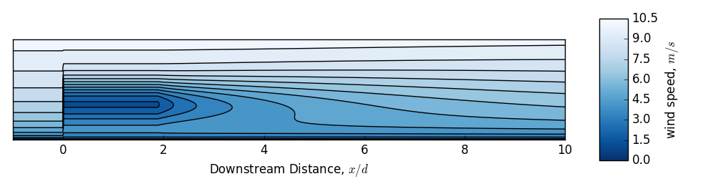
Notes:
Rotors in this waked area feel both:
1) Decrease wind velocity (so less power)
2) Increased stress (so shorter lifespan)

Slide 4
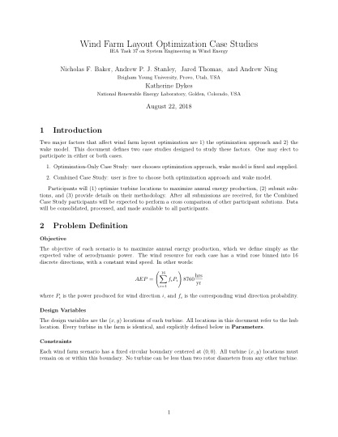
Notes:
We made two case studies
We asked for participants, got 9 with 10 submissions for case 1, 5 for case 2

Slide 5
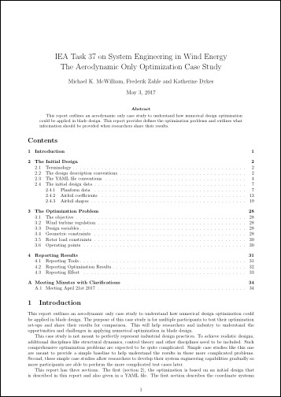
Notes:
We’re working off a past case, specific to turbines
Applying ours to a larger farm
Mike McWilliam

Slide 6
Designing the Case Studies
Notes:
Two major factors to isolate with our studies

Slide 7
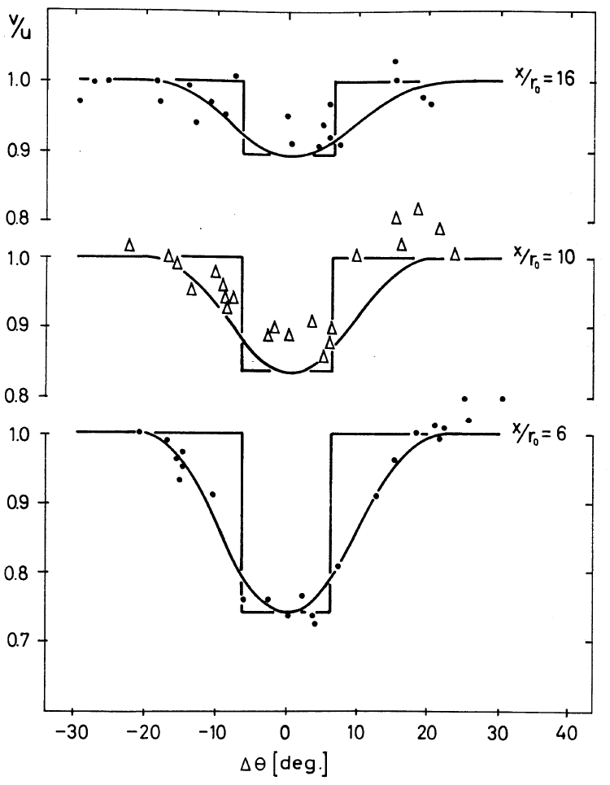
Designing the Case Studies
Wake Model
Notes:
Graphic is Jensen model

Slide 8
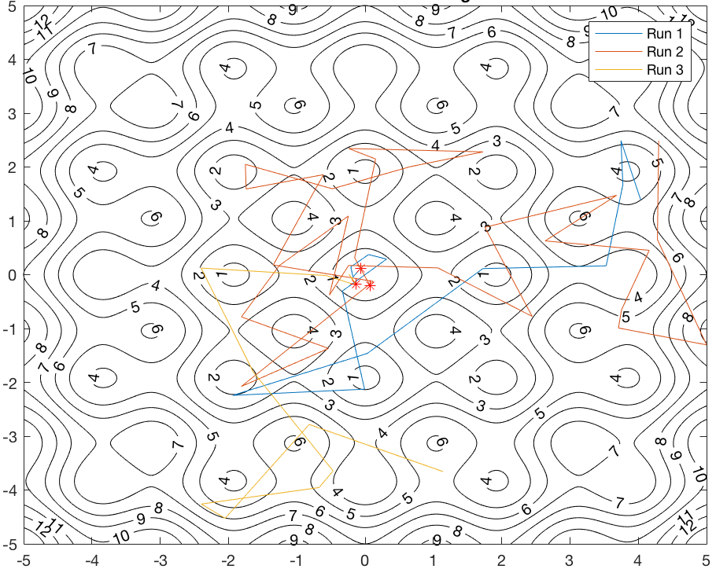
Two Variables to Isolate
Wake Model
Optimization Method
Notes:
Graphic is simulated annealing looking for an optima on a topographical map

Slide 9
Wind Farm Scenario
Notes:
We had to define a scenario

Slide 10
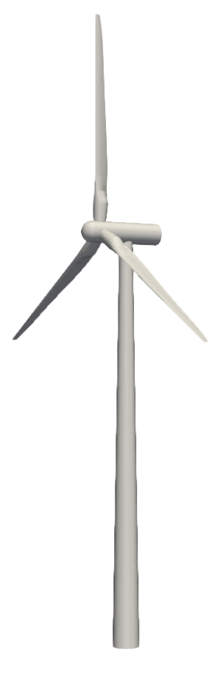
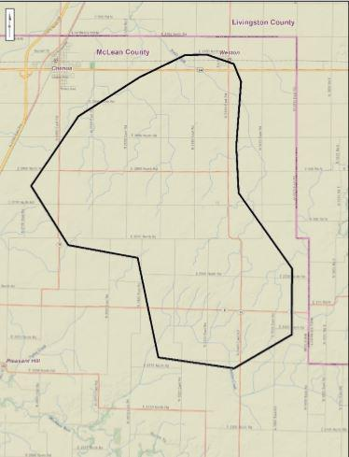
Wind Farm Scenario
Notes:
3 factors to consider are 1) Turbine, 2) Farm boundary 3) wind rose

Slide 11
Turbine:

Slide 12
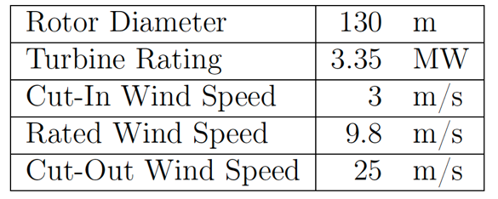
Turbine: IEA’s 3.35 MW reference
Notes:
We used 9,8 m/s as our freestream wind speed for more local optima

Slide 13
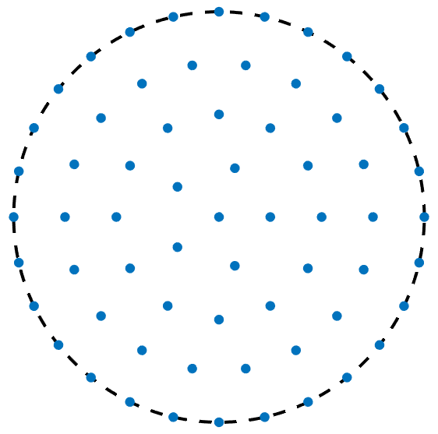
Boundary: Circular
Notes:
Square or angular boundaries, in our experience, lead to bunching at the corners.
Equidistant boundaries avoid this.
For our first case studies, we went with circular boundaries for generality

Slide 14
Wind Rose: Bimodal, off-axis
Notes:
Bimodal on-axis led to uninteresting row perpendicular to the wind direction
Omnidirectional led to grid spacing (uninteresting)
Bimodal off-axis had more variability in solutions, we hope will lead to more interesting results

Slide 15
Case Study 1

Slide 16
Case Study 1
Optimization Only (same design space)
Notes:
Here everyone used the same wake model, so everyone is in the same design space
It’s purely an optimization problem

Slide 17
Case Study 1
Optimization Only (same design space)
Bastankhah’s Gaussian Wake Model
Notes:
Used Bastankhah since it permits both gradient-free and gradient-based optimizations

Slide 18
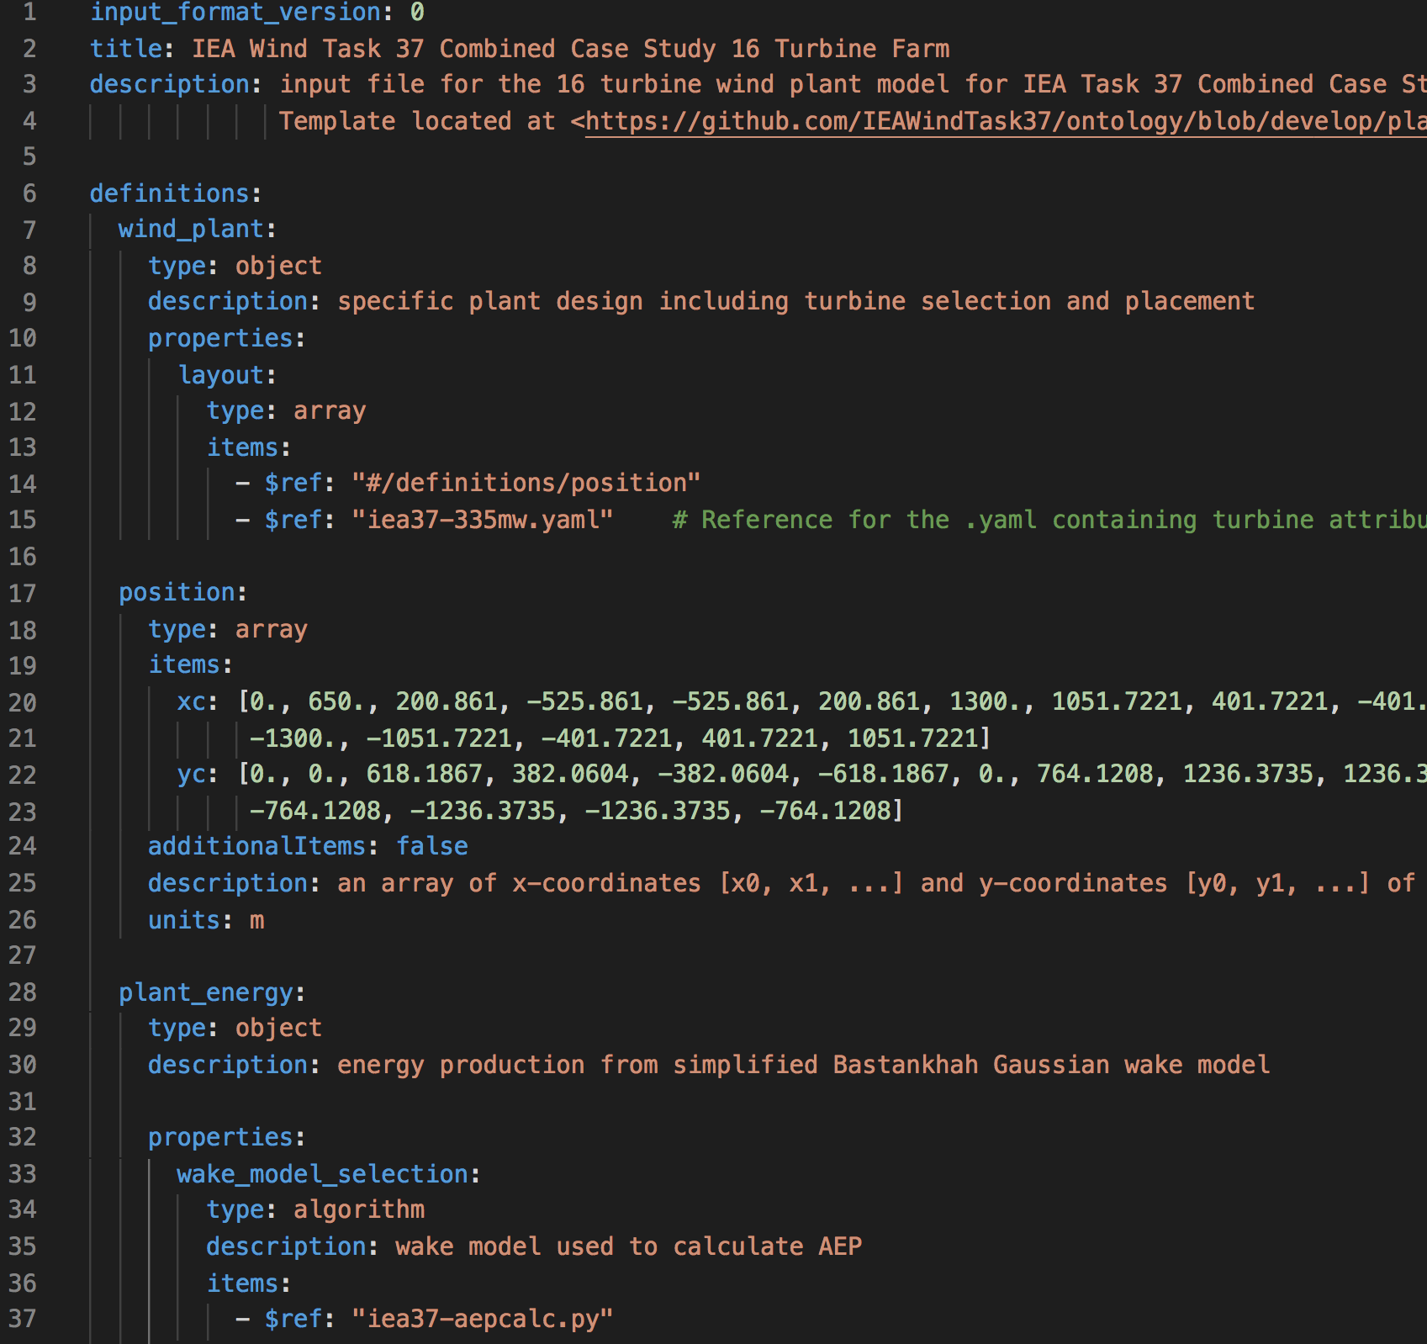
Case Study 1
Optimization Only (same design space)
Bastankhah’s Gaussian Wake Model
.yaml input files, reader supplied
Notes:
Task37 working group for ontology is working on schema for storing windfarm data in .yaml
We used a modification of their current iteration to get participants familiar in using them

Slide 19
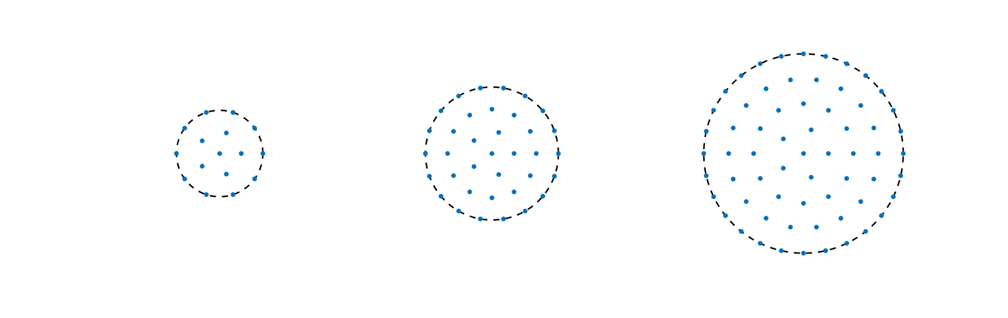
Case Study 1
Optimization Only (same design space)
Bastankhah’s Gaussian Wake Model
.yaml input files, reader supplied
3 wind farm sizes:
Notes:
3 sizing scenarios
We used perfect squares to permit grid formations
Sizes roughly double in size to test for scalability of design variables

Slide 20
Case Study 2
Notes:
Here we want to explore differences in wake models
Thus all participants are searching different design spaces

Slide 21
Case Study 2
Combined Optimization and Wake Model (different design space)
+
Notes:
But certain models preclude certain optimization methods,
so we had to let the participants pick both.

Slide 22
Case Study 2
Combined Optimization and Wake Model (different design space)
Cross-comparison for results
Notes:
We didn’t have enough time to conduct an LES
Our analysis came from a cross-comparison of participant results through their individual models

Slide 23
Case Study 2
Combined Optimization and Wake Model (different design space)
Cross-comparison for results
One farm size:
Notes:
We went with one small size for LES computation simplicity
Seems like we went too small– most results were very similar/uninteresting

Slide 24
Participants

Slide 25
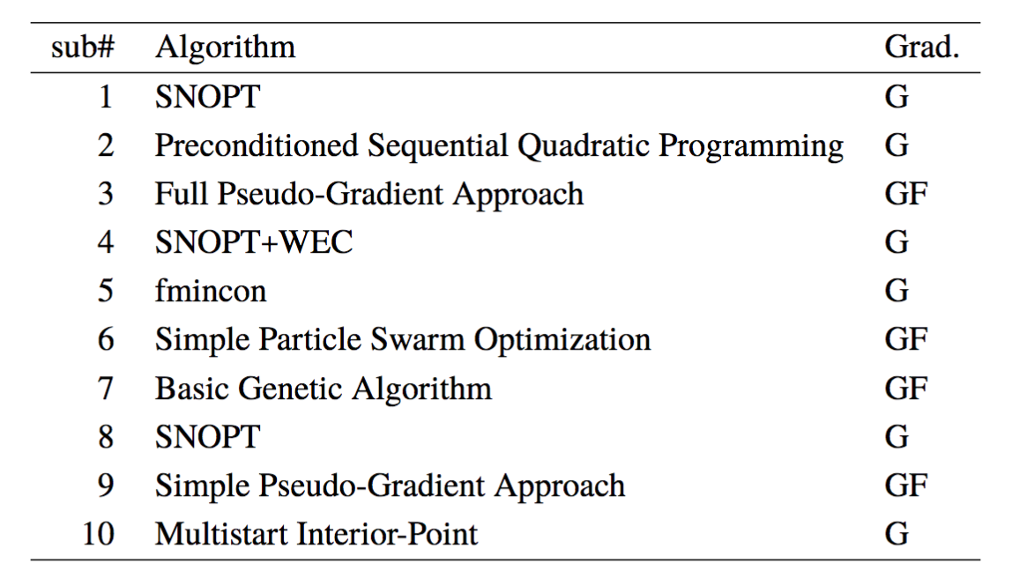
Participants
Notes:
6 gradient-based
4 gradient-free

Slide 26
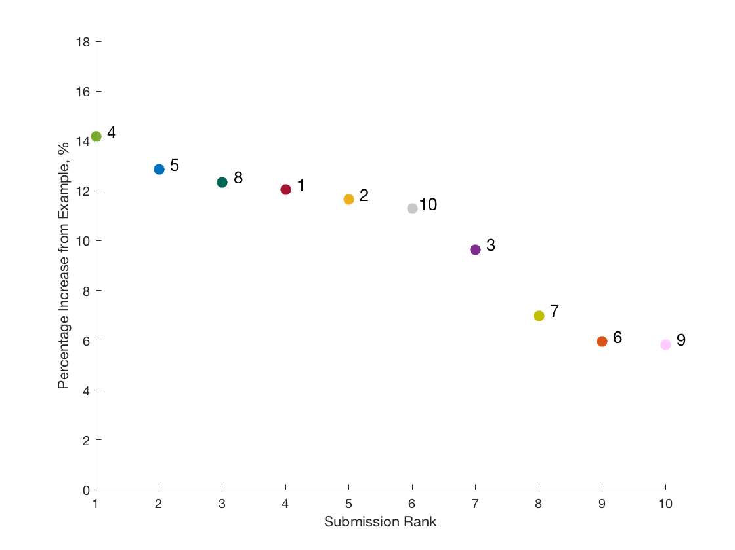
Results (cs1)
16 Turbine Case
Notes:
Trends:
#2 increased every time
#5 decreased every time
#4 kept getting best
Everyone improved on the provided example layout

Slide 27
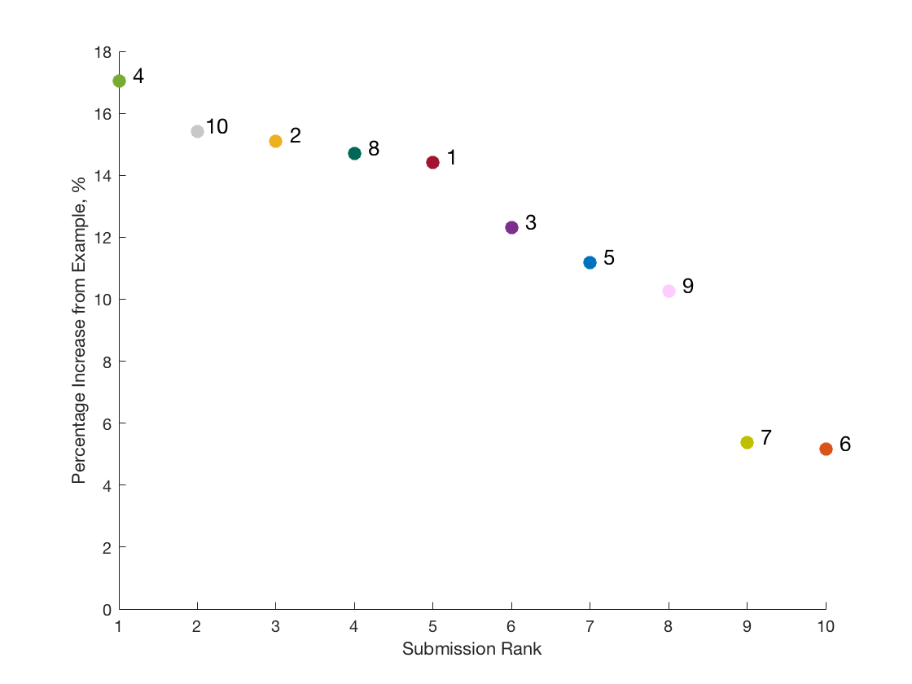
Results (cs1)
36 Turbine Case
Notes:
Trends:
#2 increased every time
#5 decreased every time
#4 kept getting best
Everyone improved on the provided example layout

Slide 28
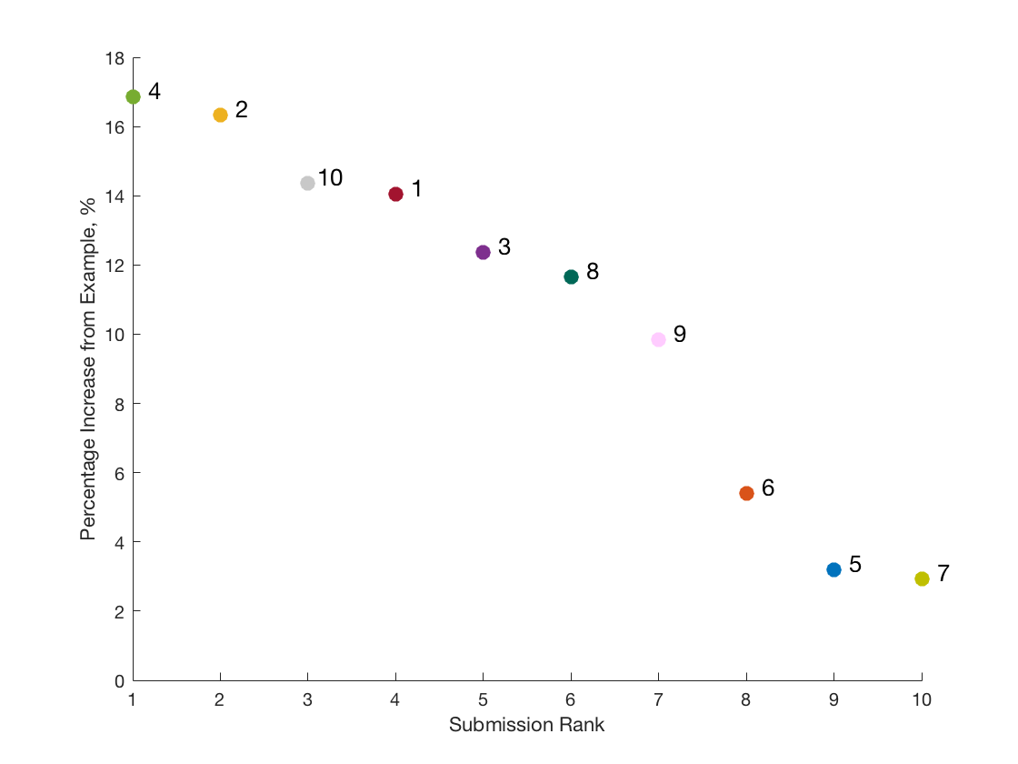
Results (cs1)
64 Turbine Case
Notes:
Trends:
#2 increased every time
#5 decreased every time
#4 kept getting best
Everyone improved on the provided example layout

Slide 29
Results (cs1)
16 Turbine Case
36 Turbine Case
64 Turbine Case
Notes:
Trends:
Spread increased with size (answers are farther apart)

Slide 30
Results (cs1)
16 Turbine Case
36 Turbine Case
64 Turbine Case
Notes:
Gradient-free methods here didn’t perform (relatively) as well as we’d hoped
Might be implementation issues
Or could be timing – not left running long enough

Slide 31
Results (cs1)
(16 Turbine Case)
Notes:
Trend to notice here is that there is no general pattern – each had a different approach.
- sub4 was highest AEP. Arrayed some on the outside, and then a row perpendicular to the wind rose
- sub2 used a rotational method to find superior result

Slide 32
Results (cs1)
(64 Turbine Case)

Slide 33
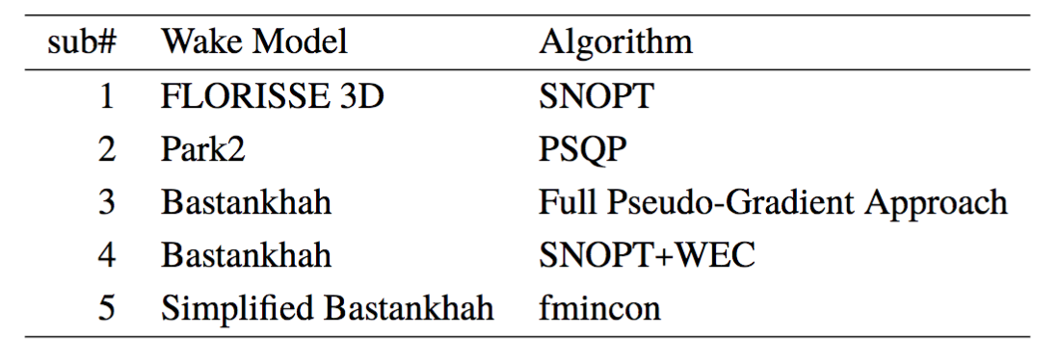
Participants
Notes:
Can’t compare because all wake models are different

Slide 34
Results (cs2)
Notes:
Interesting thing to notice here is that 1, 2, and 3 didn’t find their own placement as the best.
Means that there were optima with their model that their optimization method didn’t find – could be time, could be algorithm, could be pairing of algorithm with model.

Slide 35
Results (cs2)
Participant
Cross-Comp
sub1
sub2
sub3
sub4
sub5
sub4
sub4
sub5
sub4
sub5
Notes:
Interesting thing to notice here is that 1, 2, and 3 didn’t find their own placement as the best.
Means that there were optima with their model that their optimization method didn’t find – could be time, could be algorithm, could be pairing of algorithm with model.

Slide 36
Results (cs2)
Notes:
Interesting thing to notice here is that 1, 2, and 3 didn’t find their own placement as the best.
Means that there were optima with their model that their optimization method didn’t find – could be time, could be algorithm, could be pairing of algorithm with model.

Slide 37
Time comparison
Notes:
Of note, the top 3 submissions (#4, #2, and #10)
- All 3 used gradient-based methods
- Order of magnitudes on time are different
- Comparing 4 to 10, use of these methods is a time-tradeoff. In the 64 turbine case, sub4 found a superior result, but took about 4 times longer.
- The tradeoff in use would be time vs power – if you need a quick solution with relatively high number

Slide 38
Takeaways
In these scenarios, gradient based methods were superior

Slide 39
Takeaways
In these scenarios, gradient based methods were superior
Intuitive rotation steps by sub2

Slide 40
Takeaways
In these scenarios, gradient based methods were superior
Intuitive rotation steps by sub2
Sampling done by sub4

Slide 41
Takeaways
In these scenarios, gradient based methods were superior
Intuitive rotation steps by sub2
Sampling done by sub4
Optimizing the provided code, other languages

Slide 42
Future Work
Larger farm sizes for sub2’s trend
Clearer requirements for time measurement
More participants for next round
Notes:
ToDo:
1) Note that you corrected the 36 turbine case table from paper (insert #6)
2) Note that you corrected cs2’s naming in the results table for subs 4 and 5.

Slide 43

Nicholas F. Baker
Andrew PJ Stanley
Jared J. Thomas
Andrew Ning
Brigham Young University
Katherine Dykes
National Renewable Energy Laboratory
https://flow.byu.edu

